Slide 1
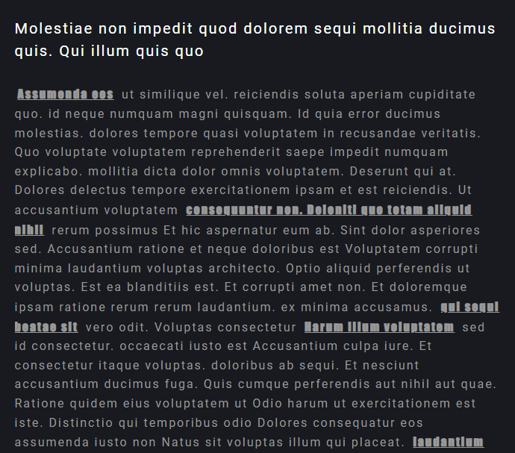
○ Impact font I however noticed that with
Impact font, sometimes the text becomes unreadable because it is too bold.

Slide 2

○ All headings and subheadings should be bold

Slide 3
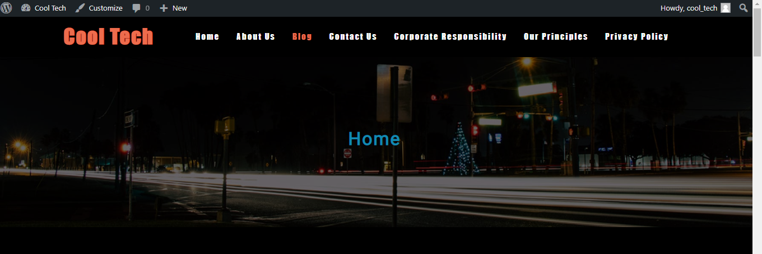
○ The main headings should be Cool Tech blue.

Slide 4
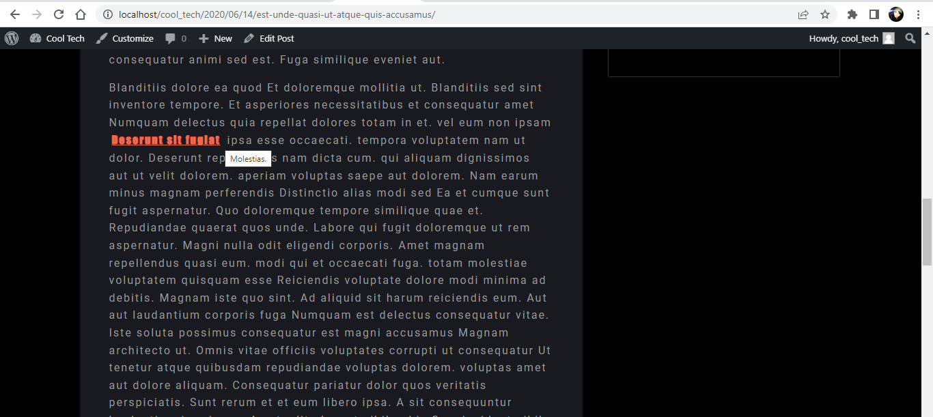
○ Links should be Cool Tech orange.

Slide 5
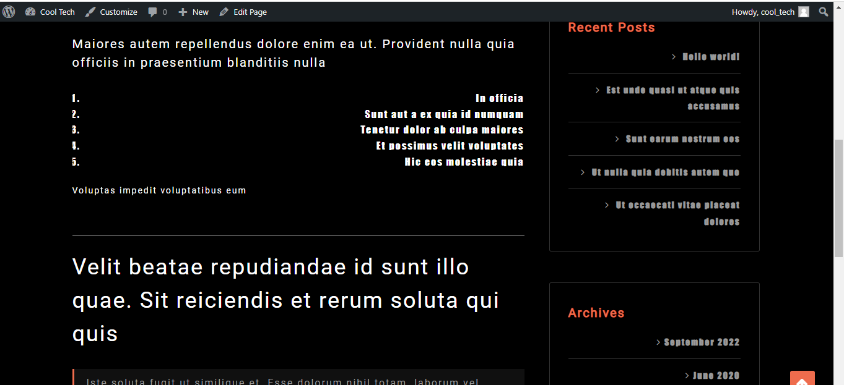
○ The listing text should be right-aligned.

Slide 6
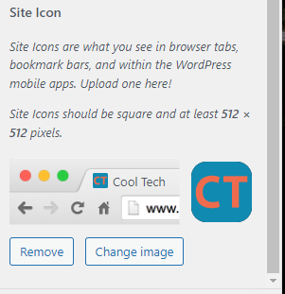
○ I also created a unique site icon with the correct colours.

Slide 7
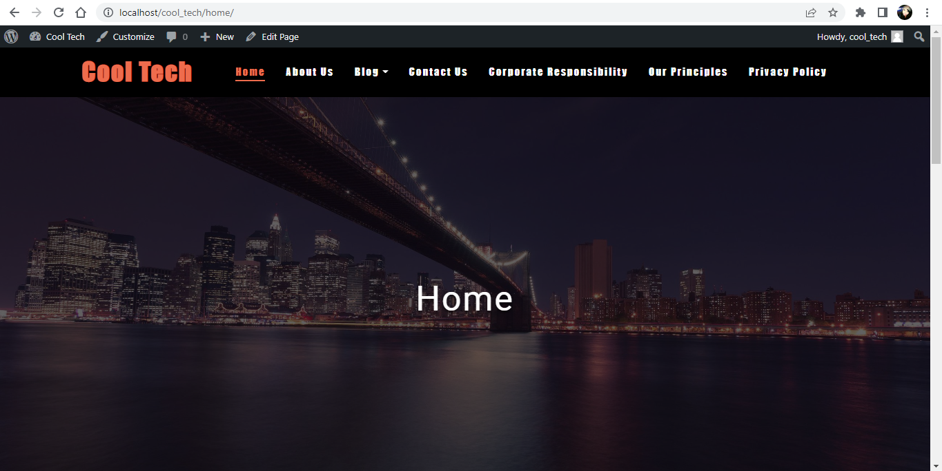
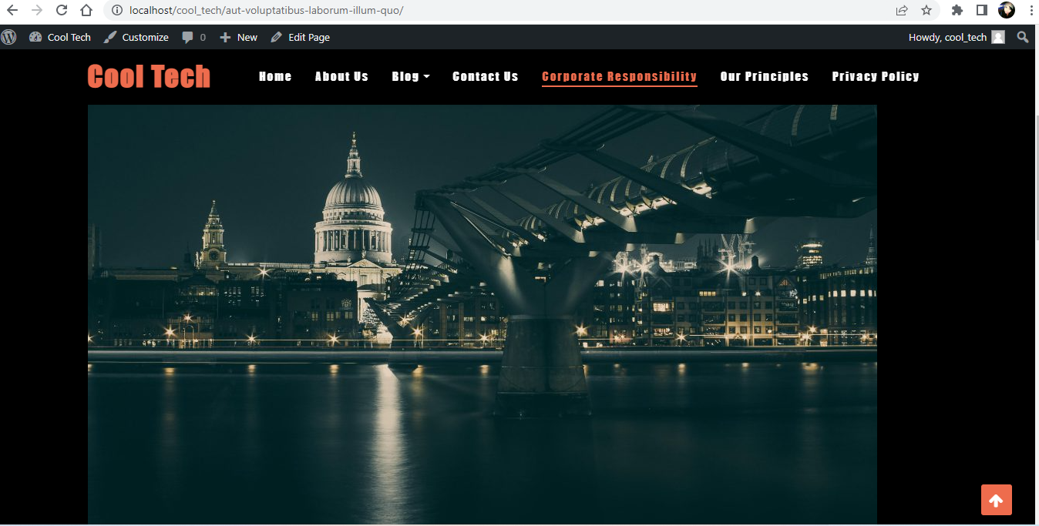
○ Images I added in from Lorem Picsum

